Slide 1
Support Vector Machine
SVM is the most popular supervised learning algorithm ,which is used for classification as well as regression problems. Primarily it is used for classification problems
SVM algorithm helps to find the best line or decision boundary, called Hyperplane that classify the data points .
SVM chooses the extreme points /vectors that helps in creating hyperplane/Decision boundary.These extreme cases are called as Support Vectors and hence algorithm is termed s Support Vector machine .

Slide 2
Types of Support Vector Machine
Linear Support vector machine(LSVM):
It is used for linearly seperable data which means if a dataset can be classified into two classes by using a single straight line ,then such data is termed as linearly seperable data and classifier is called a Linear SVM classifier
Non Linear support Vector Machine(NLSVM):
It is used for non-linearly seperated data,which means if a dataset cannot be classified using a straight line ,then such data is termed as non-linear data and classifier is called Non-Linear SVM classifier.

Slide 3

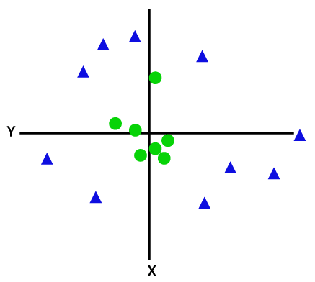
Types of Support Vector Machine
Linear Support vector machine(LSVM):
Non Linear support Vector Machine(NLSVM):

Slide 4
Support vectors:
The data points that are closest from the hyperplane these points are called as support vectors .
Margin:
The distance between the support vectors and the hyperplane is called as margin and the goal of the SVM is to maximize the margin.
Hyperplane:
The SVM algorithm helps to find the best line or decision boundary ,this best boundary or region is called as hyperplane.
Decision Boundary that helps to classify the data points.

Slide 5
Difference between linearly separable data & Non linearly separable data
linearly separable data :
linearly separable data is simple data that can be classified using simple or complex ML techniques.
Linearly separable data is data that if graphed in two dimensions, can be separated by a straight line
Data is classified with the help of hyperplane.
Non-linearly separable data:
This concept can be extended to three or more dimensions as well
We use Kernels to make non-separable data into separable data.

Slide 6
A kernel Transforms a low dimensional input data into a higher dimensional space.
It converts non linear separable problem to linear separable problems by adding more dimensions to it ,thus a kernel trick helps us to build a more accurate classifier hence it is useful in non linear separation problems.

Slide 7
Pros & cons of SVM
Pros:
It works really well with a clear margin of separation.
It is effective in high dimensional spaces
Cons:
It doesn't perform well when we have large data set because the required training time is higher.
SVM does not perform very well when the data set has more noise i.e. target classes are overlapping.

Slide 8
Applications of SVM
1)Face detection:
SVM classify parts of the image as a face & non-face & create a square boundary around the face
2.Classification of Images
SVMs can classify images with higher search accuracy. Its accuracy is higher than traditional query-based refinement schemes
3. Text and Hypertext Categorization
4. Handwriting Recognition
We can also use SVMs to recognize hand-written characters that use for data entry and validating signatures on documents.

